Slide 1
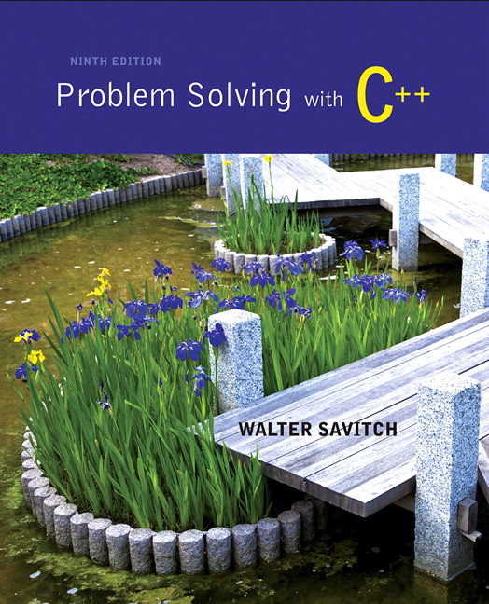
Problem Solving with C++ by Walter Savitch

Slide 2
Chapter 10
Defining Classes

Slide 3
Overview
10.1 Structures
10.2 Classes
10.3 Abstract Data Types
10.4 Introduction to Inheritance

Slide 4
10.1
Structures

Slide 5
What Is a Class?
A class is a data type whose variables are objects
Some pre-defined data types you have used are
int
char
A pre-defined class you have used is
ifstream
You can define your own classes as well

Slide 6
Class Definitions
A class definition includes
A description of the kinds of values the variable can hold
A description of the member functions
We will start by defining structures as a first step toward defining classes

Slide 7
Structures
A structure can be viewed as an object
Contains no member functions (The structures used here have no member functions)
Contains multiple values of possibly different types
The multiple values are logically related as a single item
Example: A bank Certificate of Deposit (CD) has the following values: a balance an interest rate a term (months to maturity)

Slide 8
The CD Definition
The Certificate of Deposit structure can be defined as struct CDAccount { double balance; double interest_rate; int term; //months to maturity };
Keyword struct begins a structure definition
CDAccount is the structure tag or the structure’s type
Member names are identifiers declared in the braces
Remember this semicolon!

Slide 9
Using the Structure
Structure definition is generally placed outside any function definition
This makes the structure type available to all code that follows the structure definition
To declare two variables of type CDAccount: CDAccount my_account, your_account;
My_account and your_account contain distinct member variables balance, interest_rate, and term

Slide 10
The Structure Value
The Structure Value
Consists of the values of the member variables
The value of an object of type CDAccount
Consists of the values of the member variables balance interest_rate term

Slide 11
Specifying Member Variables
Member variables are specific to the structure variable in which they are declared
Syntax to specify a member variable: Structure_Variable_Name . Member_Variable_Name
Given the declaration: CDAccount my_account, your_account;
Use the dot operator to specify a member variable my_account.balance my_account.interest_rate my_account.term

Slide 12
Using Member Variables
Member variables can be used just as any other variable of the same type
my_account.balance = 1000; your_account.balance = 2500;
Notice that my_account.balance and your_account.balance are different variables!
my_account.balance = my_account.balance + interest;

Slide 13
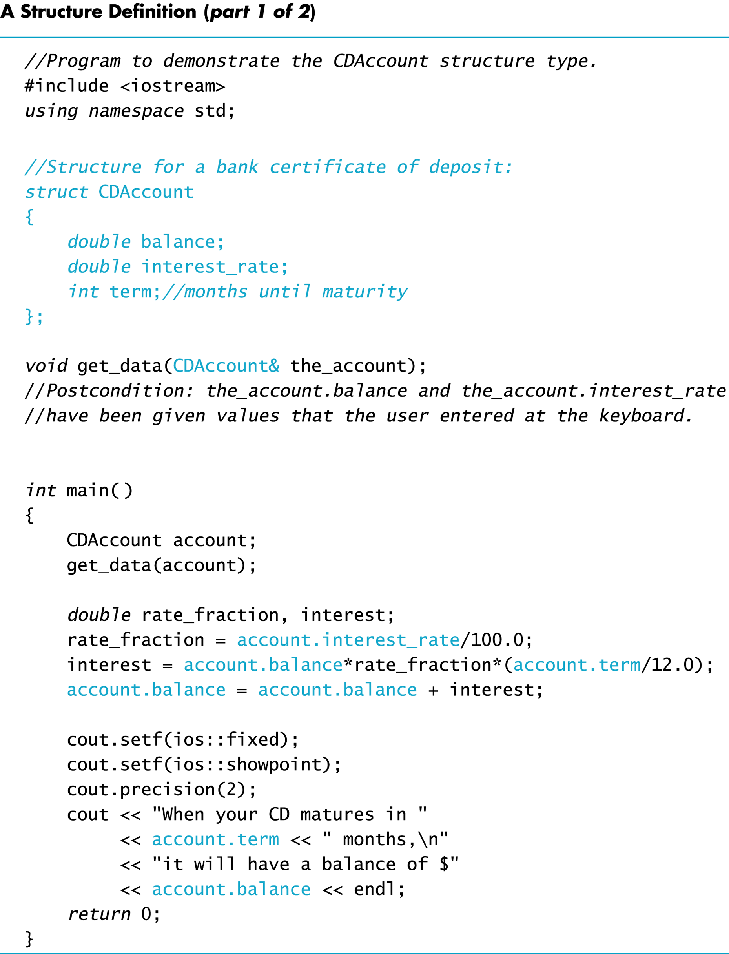
Display 10.1 (1/2)

Slide 14
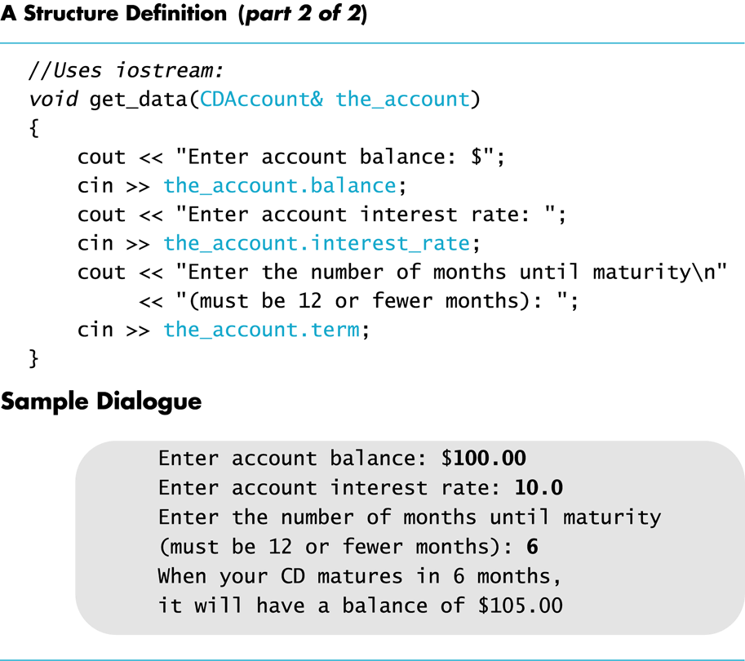
Display 10.1 (2/2)

Slide 15
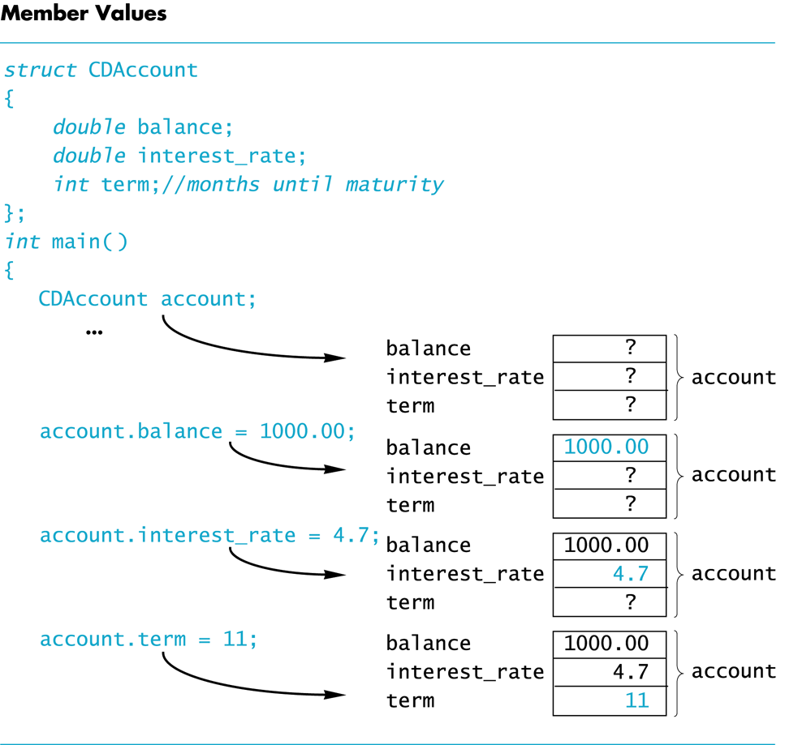
Display 10.2

Slide 16
Duplicate Names
Member variable names duplicated between structure types are not a problem.
super_grow.quantity and apples.quantity are different variables stored in different locations
struct FertilizerStock { double quantity; double nitrogen_content; }; FertilizerStock super_grow;
struct CropYield { int quantity; double size; }; CropYield apples;

Slide 17
Structures as Arguments
Structures can be arguments in function calls
The formal parameter can be call-by-value
The formal parameter can be call-by-reference
Example: void get_data(CDAccount& the_account);
Uses the structure type CDAccount we saw earlier as the type for a call-by-reference parameter

Slide 18
Structures as Return Types
Structures can be the type of a value returned by a function
Example: CDAccount shrink_wrap(double the_balance, double the_rate, int the_term) { CDAccount temp; temp.balance = the_balance; temp.interest_rate = the_rate; temp.term = the_term; return temp; }

Slide 19
Using Function shrink_wrap
shrink_wrap builds a complete structure value in temp, which is returned by the function
We can use shrink_wrap to give a variable of type CDAccount a value in this way: CDAccount new_account; new_account = shrink_wrap(1000.00, 5.1, 11);

Slide 20
Assignment and Structures
The assignment operator can be used to assign values to structure types
Using the CDAccount structure again: CDAccount my_account, your_account; my_account.balance = 1000.00; my_account.interest_rate = 5.1; my_account.term = 12; your_account = my_account;
Assigns all member variables in your_account the corresponding values in my_account

Slide 21
Hierarchical Structures
Structures can contain member variables that are also structures
struct PersonInfo contains a Date structure
struct PersonInfo { double height; int weight; Date birthday; };
struct Date { int month;
int day;
int year; };

Slide 22
Using PersonInfo
A variable of type PersonInfo is declared by
PersonInfo person1;
To display the birth year of person1, first access the birthday member of person1 cout << person1.birthday…
But we want the year, so we now specify the year member of the birthday member cout << person1.birthday.year;

Slide 23
Initializing Classes
A structure can be initialized when declared
Example: struct Date { int month; int day; int year; };
Can be initialized in this way Date due_date = {12, 31, 2004};

Slide 24
Section 10.1 Conclusion
Can you
Write a definition for a structure type for records consisting of a person’s wage rate, accrued vacation (in whole days), and status (hourly or salaried). Represent the status as one of the two character values ‘H’ and ‘S’. Call the type EmployeeRecord.

Slide 25
10.2
Classes

Slide 26
Classes
A class is a data type whose variables are objects
The definition of a class includes
Description of the kinds of values of the member variables
Description of the member functions
A class description is somewhat like a structure definition plus the member variables

Slide 27
A Class Example
To create a new type named DayOfYear as a class definition
Decide on the values to represent
This example’s values are dates such as July 4 using an integer for the number of the month
Member variable month is an int (Jan = 1, Feb = 2, etc.)
Member variable day is an int
Decide on the member functions needed
We use just one member function named output

Slide 28
Class DayOfYear Definition
class DayOfYear { public: void output( ); int month; int day; };
Member Function Declaration

Slide 29
Defining a Member Function
Member functions are declared in the class declaration
Member function definitions identify the class in which the function is a member
void DayOfYear::output() { cout << “month = “ << month << “, day = “ << day << endl; }

Slide 30
Member Function Definition
Member function definition syntax: Returned_Type Class_Name::Function_Name(Parameter_List) { Function Body Statements }
Example: void DayOfYear::output( ) { cout << “month = “ << month << “, day = “ << day << endl; }

Slide 31
The ‘::’ Operator
‘::’ is the scope resolution operator
Tells the class a member function is a member of
void DayOfYear::output( ) indicates that function output is a member of the DayOfYear class
The class name that precedes ‘::’ is a type qualifier

Slide 32
‘::’ and ‘.’
‘::’ used with classes to identify a member void DayOfYear::output( ) { // function body }
‘.’used with variables to identify a member DayOfYear birthday; birthday.output( );

Slide 33
Calling Member Functions
Calling the DayOfYear member function output is done in this way: DayOfYear today, birthday; today.output( ); birthday.output( );
Note that today and birthday have their own versions of the month and day variables for use by the output function

Slide 34
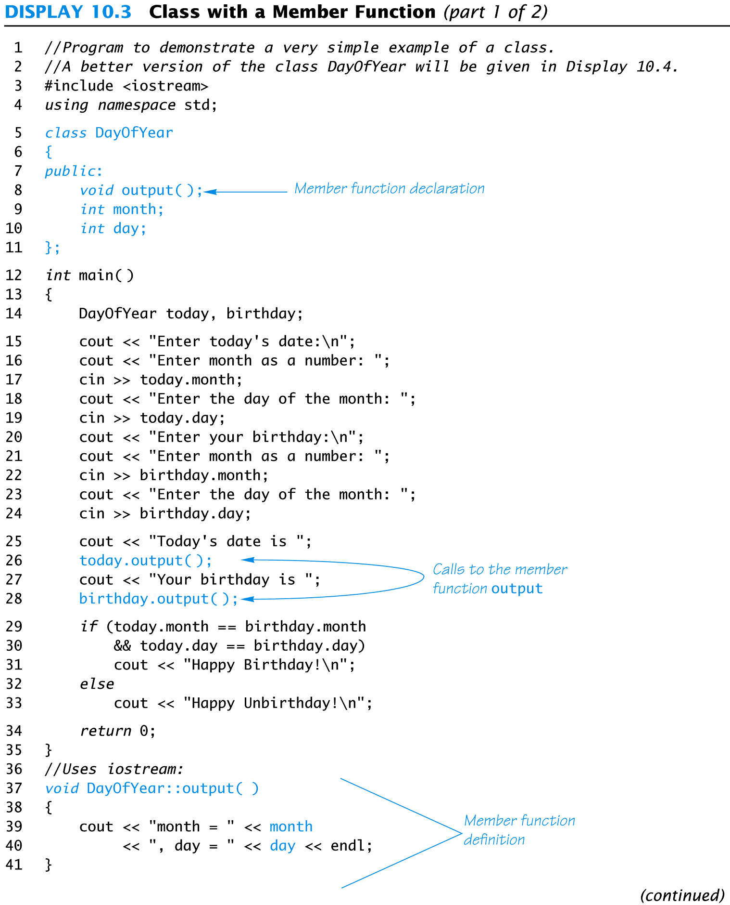
Display 10.3 (1/2)

Slide 35
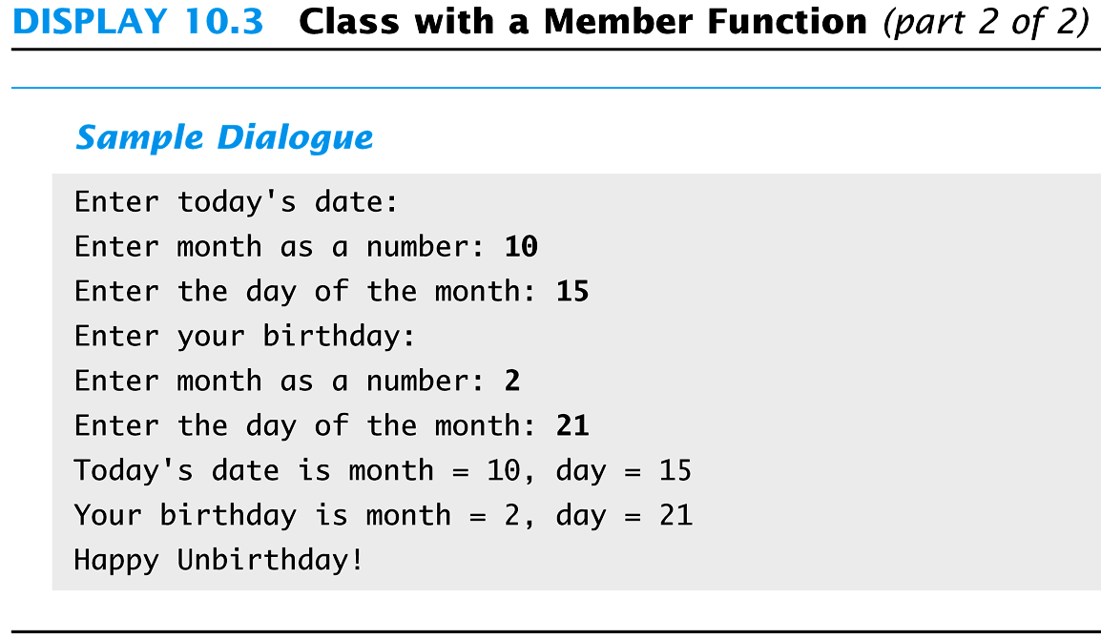
Display 10.3 (2/2)

Slide 36
Encapsulation
Encapsulation is
Combining a number of items, such as variables and functions, into a single package such as an object of a class

Slide 37
Problems With DayOfYear
Changing how the month is stored in the class DayOfYear requires changes to the program
If we decide to store the month as three characters (JAN, FEB, etc.) instead of an int
cin >> today.month will no longer work because we now have three character variables to read
if(today.month == birthday.month) will no longer work to compare months
The member function “output” no longer works

Slide 38
Ideal Class Definitions
Changing the implementation of DayOfYear requires changes to the program that uses DayOfYear
An ideal class definition of DayOfYear could be changed without requiring changes to the program that uses DayOfYear

Slide 39
Fixing DayOfYear
To fix DayOfYear
We need to add member functions to use when changing or accessing the member variables
If the program never directly references the member variables, changing how the variables are stored will not require changing the program
We need to be sure that the program does not ever directly reference the member variables

Slide 40
Public Or Private?
C++ helps us restrict the program from directly referencing member variables
private members of a class can only be referenced within the definitions of member functions
If the program tries to access a private member, the compiler gives an error message
Private members can be variables or functions

Slide 41
Private Variables
Private variables cannot be accessed directly by the program
Changing their values requires the use of public member functions of the class
To set the private month and day variables in a new DayOfYear class use a member function such as void DayOfYear::set(int new_month, int new_day) { month = new_month; day = new_day; }

Slide 42
Public or Private Members
The keyword private identifies the members of a class that can be accessed only by member functions of the class
Members that follow the keyword private are private members of the class
The keyword public identifies the members of a class that can be accessed from outside the class
Members that follow the keyword public are public members of the class

Slide 43
A New DayOfYear
The new DayOfYear class demonstrated in Display 10.4…
Uses all private member variables
Uses member functions to do all manipulation of the private member variables
Member variables and member function definitions can be changed without changes to the program that uses DayOfYear

Slide 44
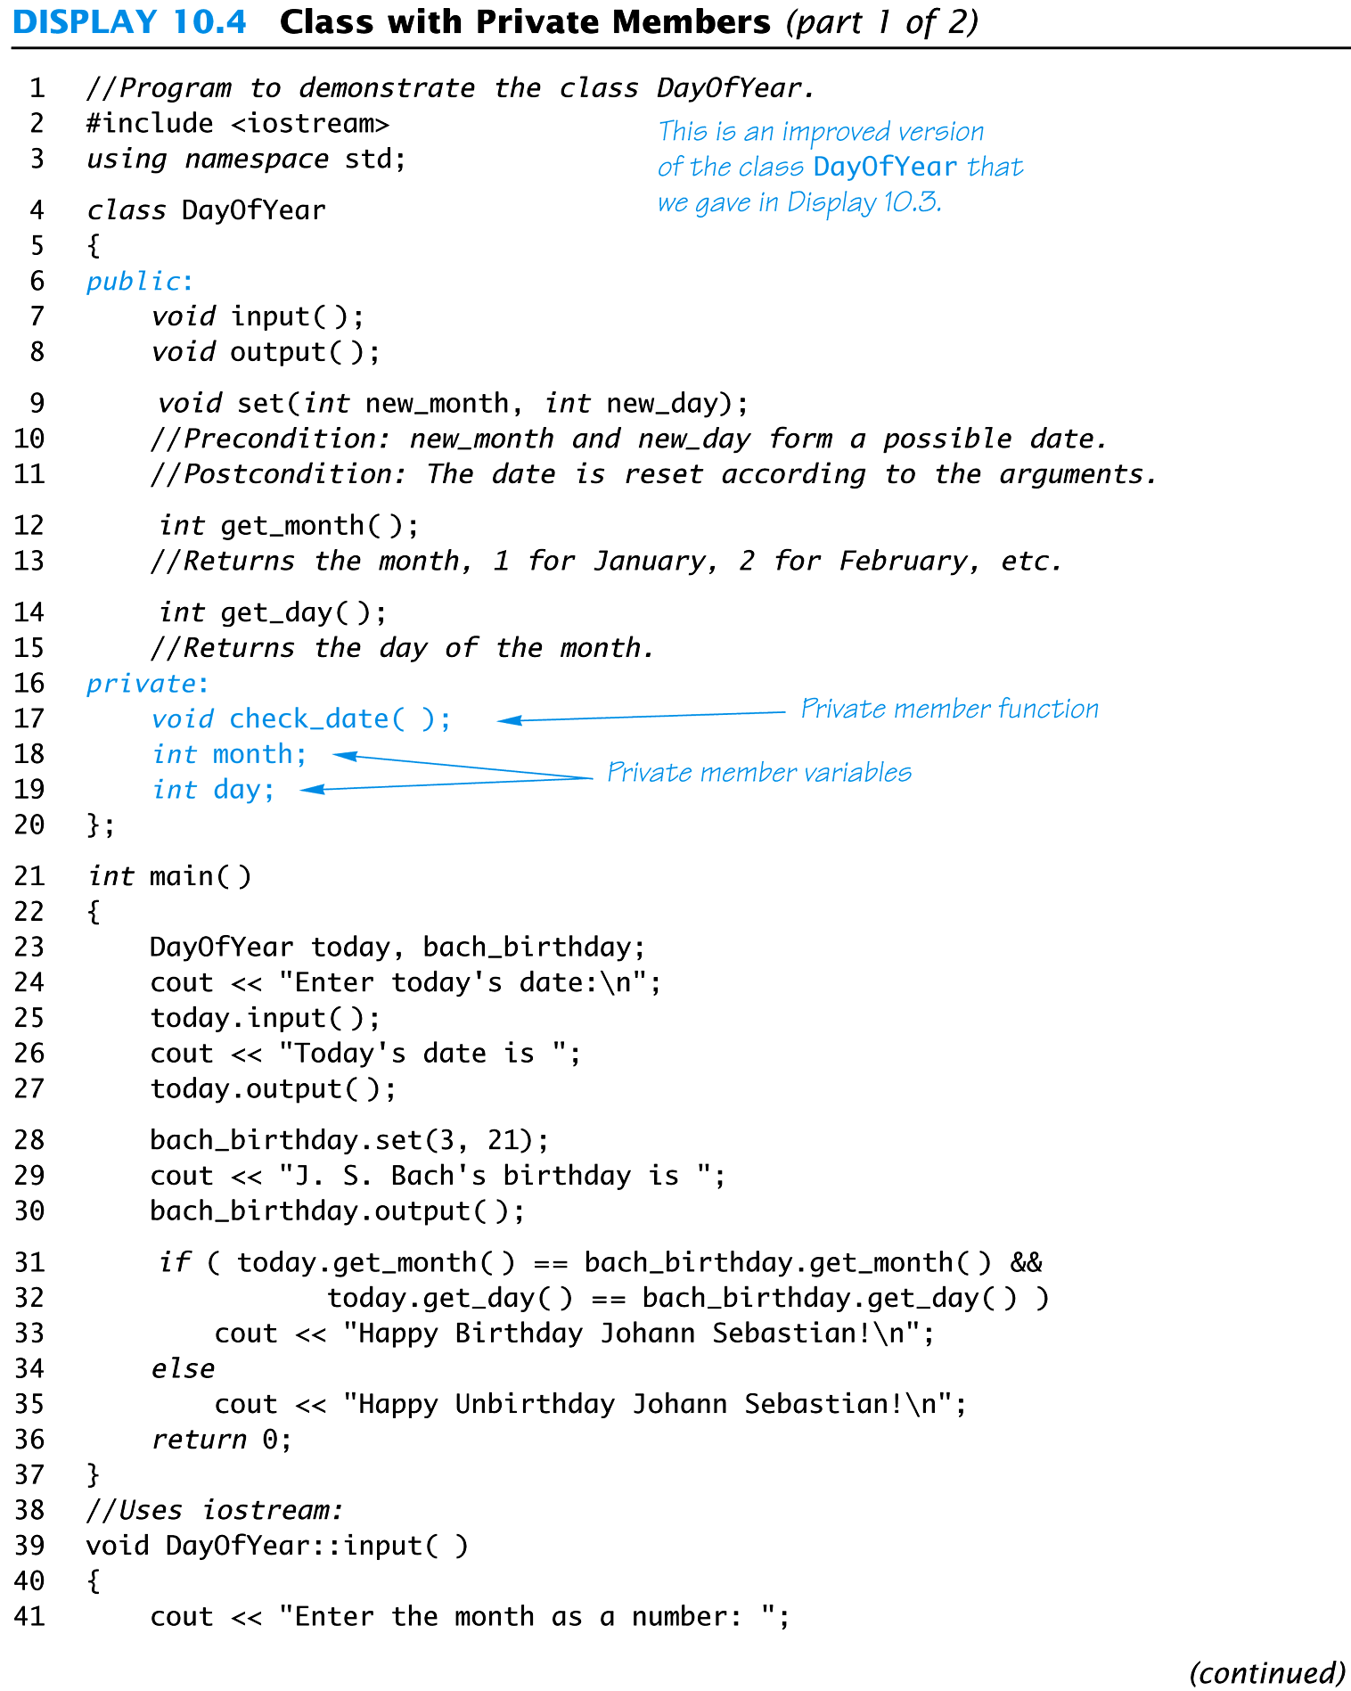
Display 10.4 (1/2)

Slide 45
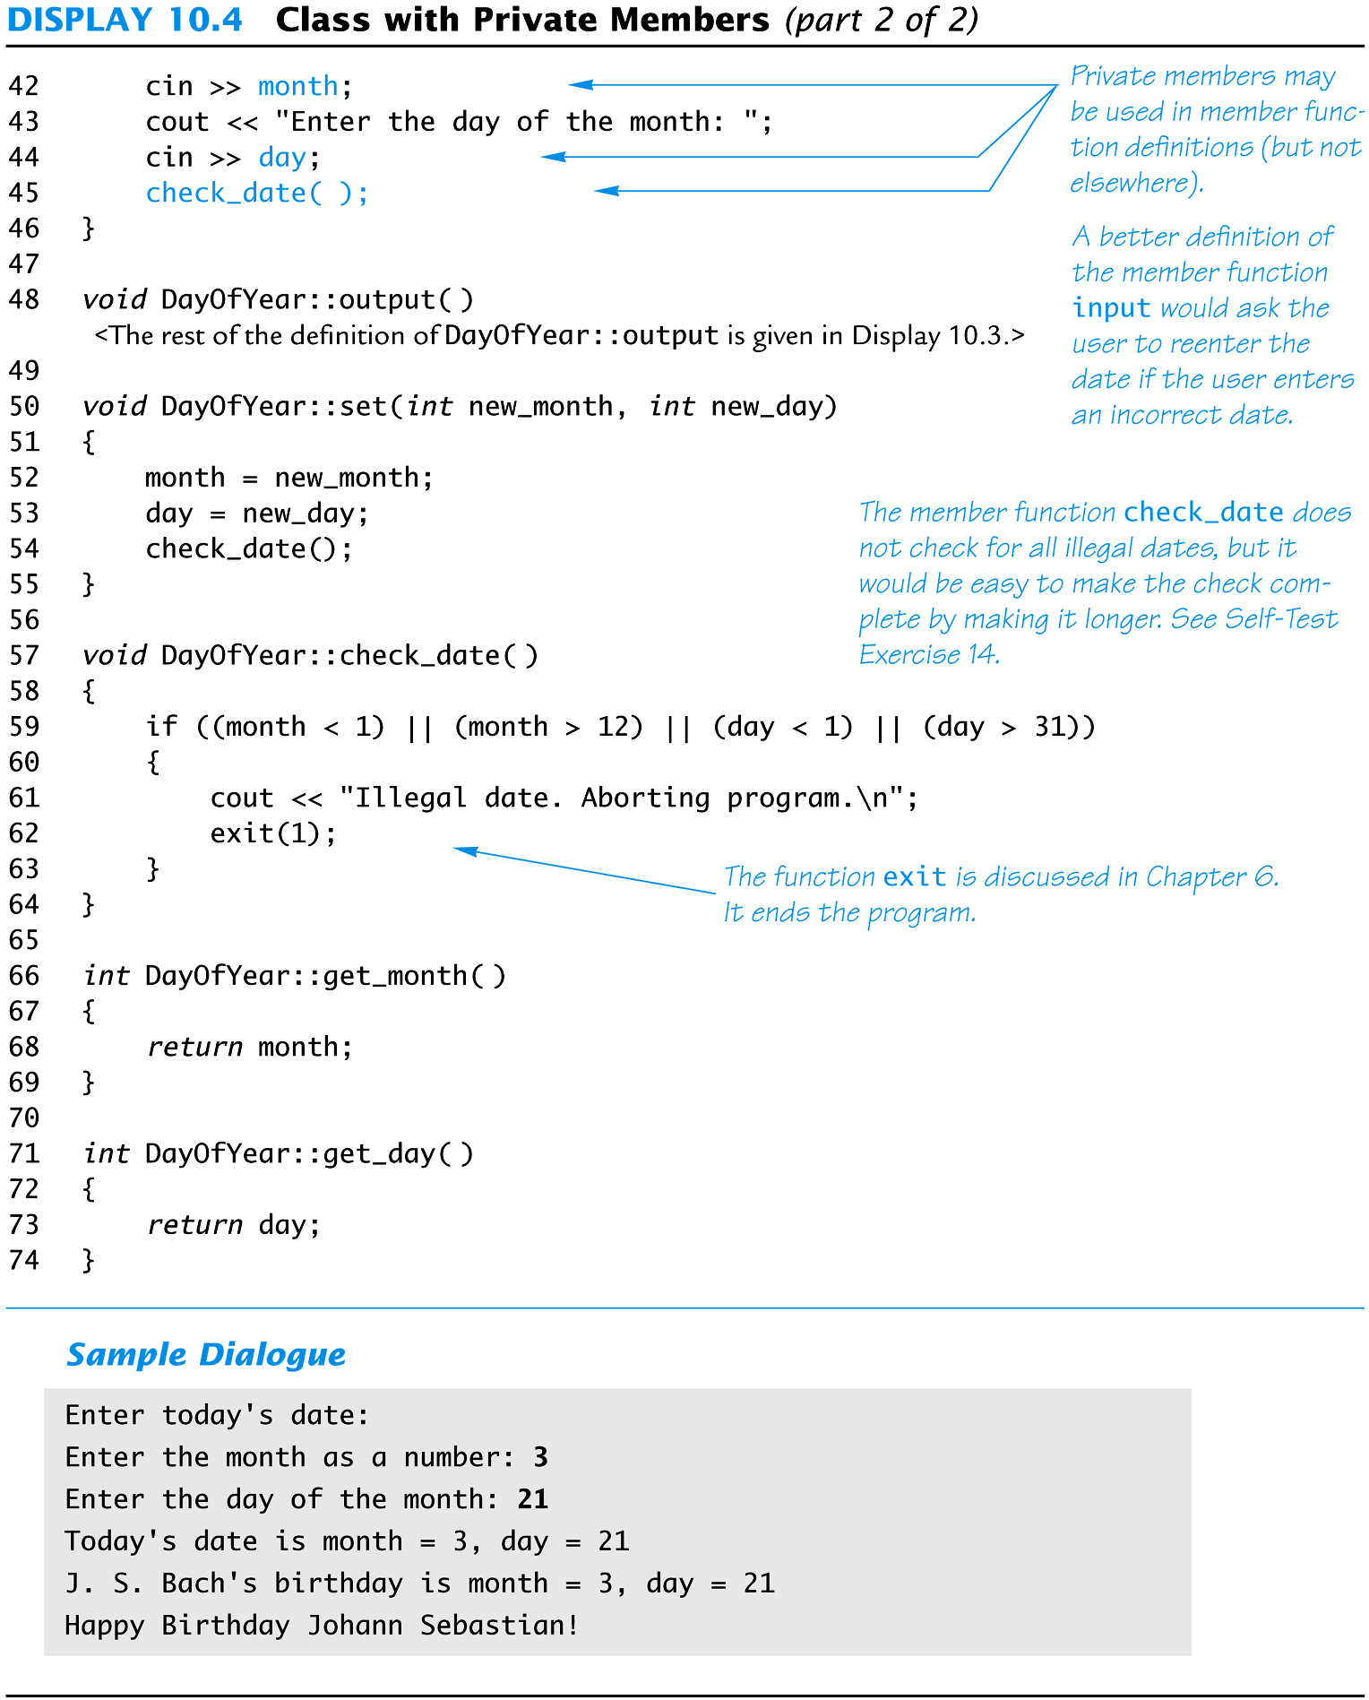
Display 10.4 (2/2)

Slide 46
Using Private Variables
It is normal to make all member variables private
Private variables require member functions to perform all changing and retrieving of values
Accessor functions allow you to obtain the values of member variables
Example: get_day in class DayOfYear
Mutator functions allow you to change the values of member variables
Example: set in class DayOfYear

Slide 47
General Class Definitions
The syntax for a class definition is
class Class_Name { public: Member_Specification_1 Member_Specification_2 … Member_Specification_3 private: Member_Specification_n+1 Member_Specification_n+2 … };

Slide 48
Declaring an Object
Once a class is defined, an object of the class is declared just as variables of any other type
Example: To create two objects of type Bicycle:
class Bicycle { // class definition lines }; Bicycle my_bike, your_bike;

Slide 49
The Assignment Operator
Objects and structures can be assigned values with the assignment operator (=)
Example: DayOfYear due_date, tomorrow; tomorrow.set(11, 19); due_date = tomorrow;

Slide 50
Program Example: BankAccount Class
This bank account class allows
Withdrawal of money at any time
All operations normally expected of a bank account (implemented with member functions)
Storing an account balance
Storing the account’s interest rate

Slide 51
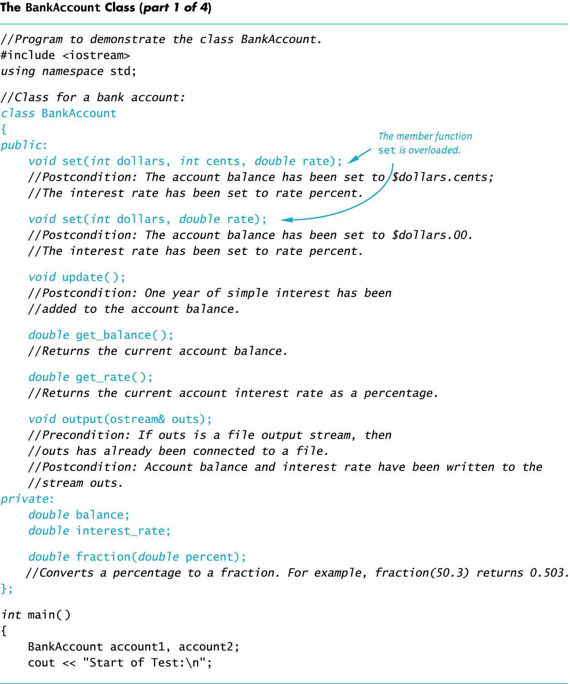
Display 10.5 (1/4)

Slide 52
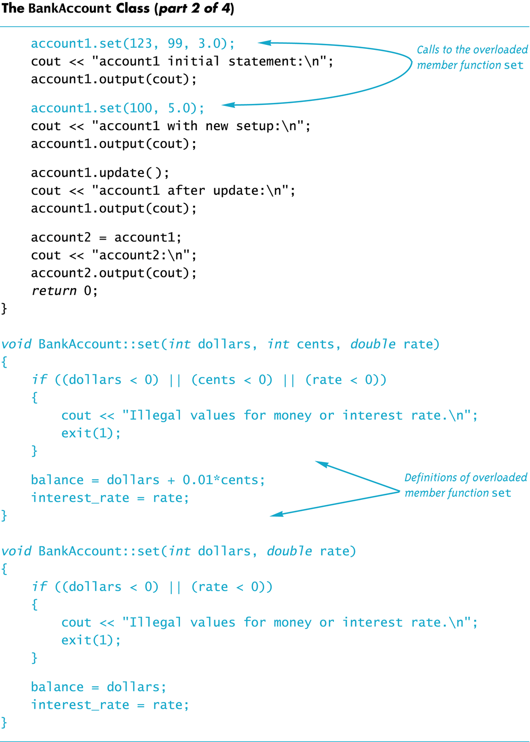
Display 10.5 (2/4)

Slide 53
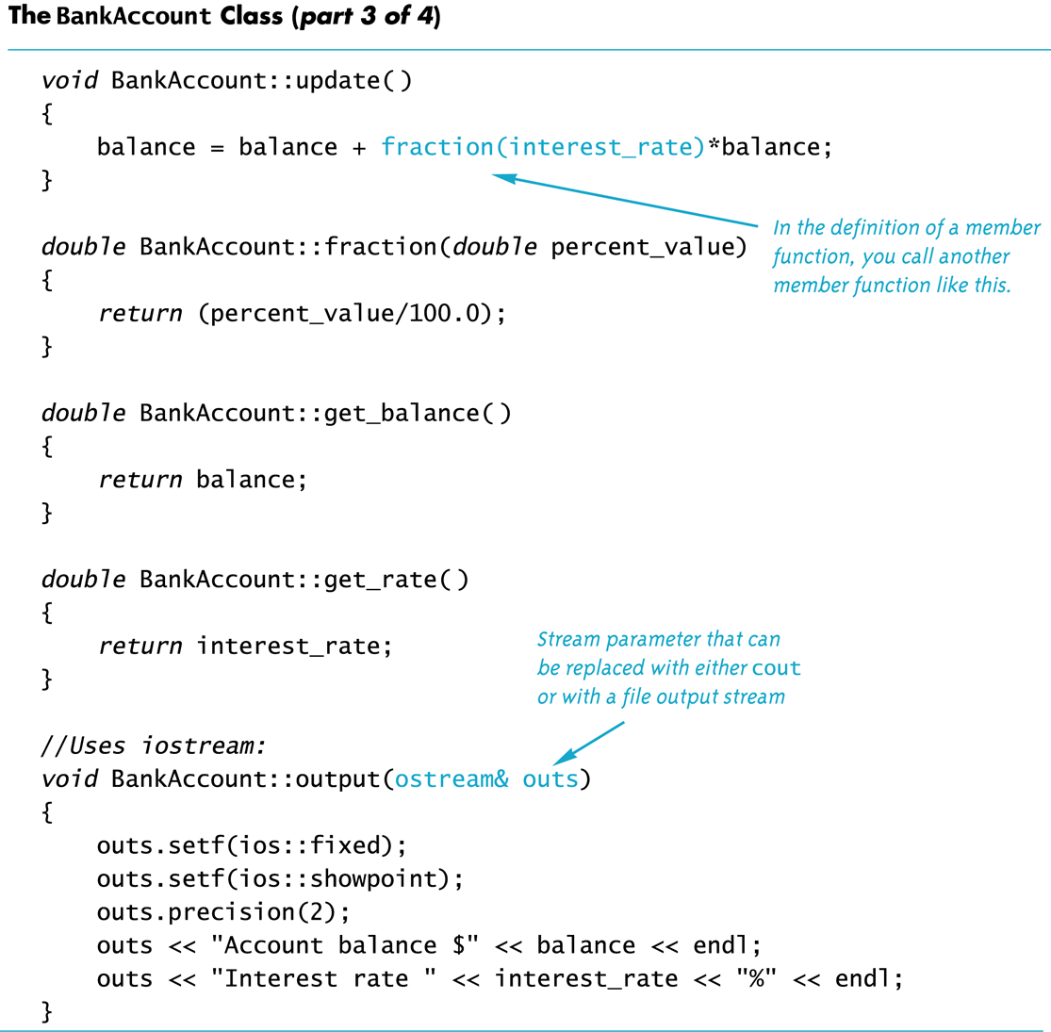
Display 10.5 (3/4)

Slide 54
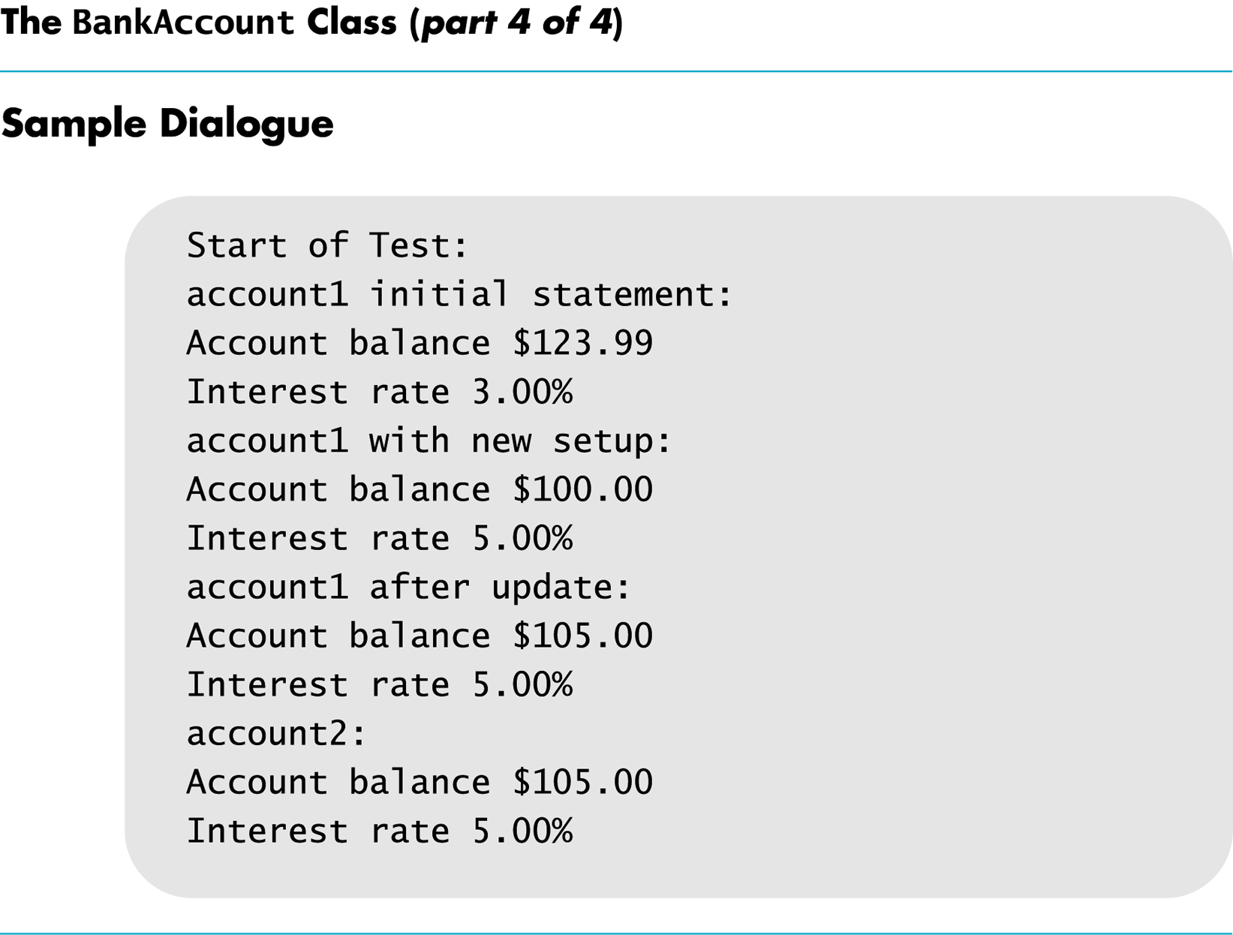
Display 10.5 (4/4)

Slide 55
Calling Public Members
Recall that if calling a member function from the main function of a program, you must include the the object name: account1.update( );

Slide 56
Calling Private Members
When a member function calls a private member function, an object name is not used
fraction (double percent); is a private member of the BankAccount class
fraction is called by member function update void BankAccount::update( ) { balance = balance + fraction(interest_rate)* balance; }

Slide 57
Constructors
A constructor can be used to initialize member variables when an object is declared
A constructor is a member function that is usually public
A constructor is automatically called when an object of the class is declared
A constructor’s name must be the name of the class
A constructor cannot return a value
No return type, not even void, is used in declaring or defining a constructor

Slide 58
Constructor Declaration
A constructor for the BankAccount class could be declared as: class BankAccount { public: BankAccount(int dollars, int cents, double rate); //initializes the balance to $dollars.cents //initializes the interest rate to rate percent …//The rest of the BankAccount definition };

Slide 59
Constructor Definition
The constructor for the BankAccount class could be defined as BankAccount::BankAccount(int dollars, int cents, double rate) { if ((dollars < 0) || (cents < 0) || ( rate < 0 )) { cout << “Illegal values for money or rate\n”; exit(1); } balance = dollars + 0.01 * cents; interest_rate = rate; }
Note that the class name and function name are the same

Slide 60
Calling A Constructor (1)
A constructor is not called like a normal member function: BankAccount account1; account1.BankAccount(10, 50, 2.0);

Slide 61
Calling A Constructor (2)
A constructor is called in the object declaration BankAccount account1(10, 50, 2.0);
Creates a BankAccount object and calls the constructor to initialize the member variables

Slide 62
Overloading Constructors
Constructors can be overloaded by defining constructors with different parameter lists
Other possible constructors for the BankAccount class might be BankAccount (double balance, double interest_rate); BankAccount (double balance); BankAccount (double interest_rate); BankAccount ( );

Slide 63
The Default Constructor
A default constructor uses no parameters
A default constructor for the BankAccount class could be declared in this way class BankAccount { public: BankAccount( ); // initializes balance to $0.00 // initializes rate to 0.0% … // The rest of the class definition };

Slide 64
Default Constructor Definition
The default constructor for the BankAccount class could be defined as BankAccount::BankAccount( ) { balance = 0; rate = 0.0; }
It is a good idea to always include a default constructor even if you do not want to initialize variables

Slide 65
Calling the Default Constructor
The default constructor is called during declaration of an object
An argument list is not used BankAccount account1; // uses the default BankAccount constructor BankAccount account1( ); // Is not legal

Slide 66
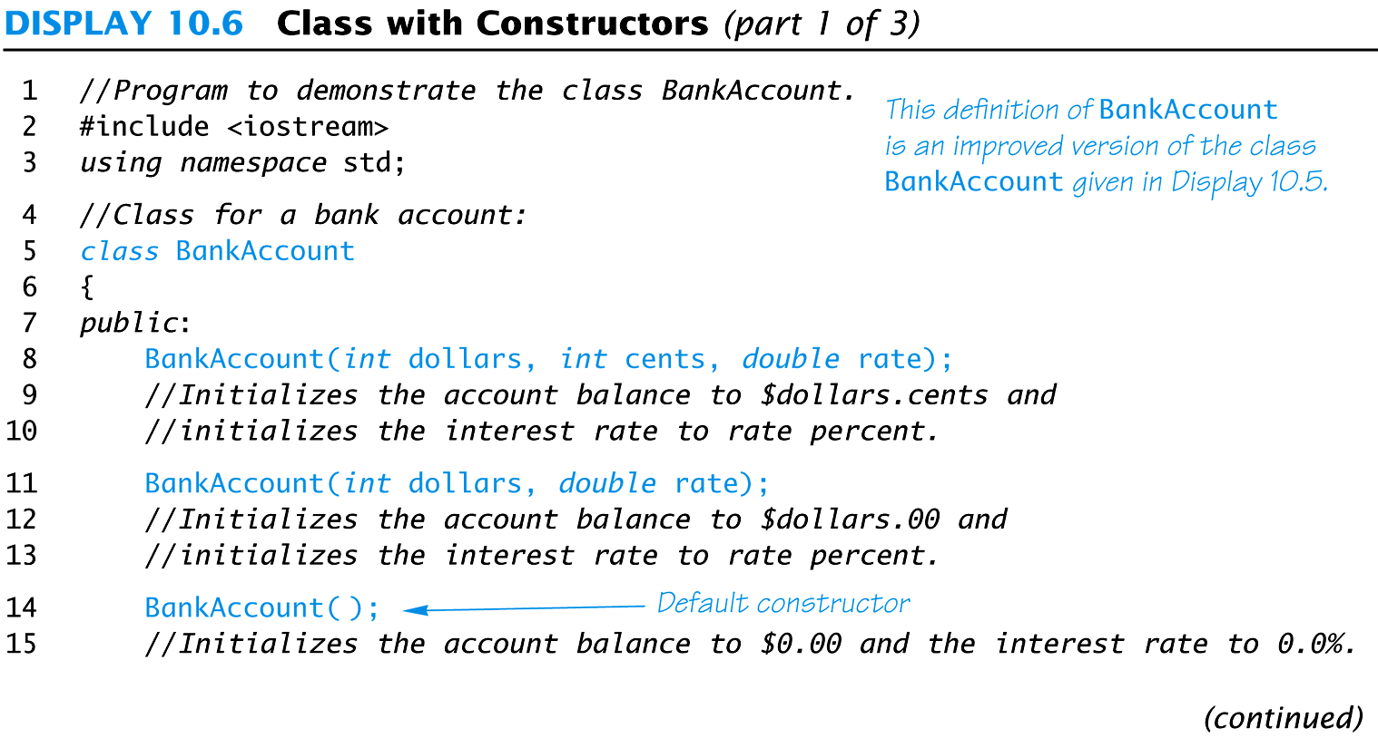
Display 10.6 (1/3)

Slide 67
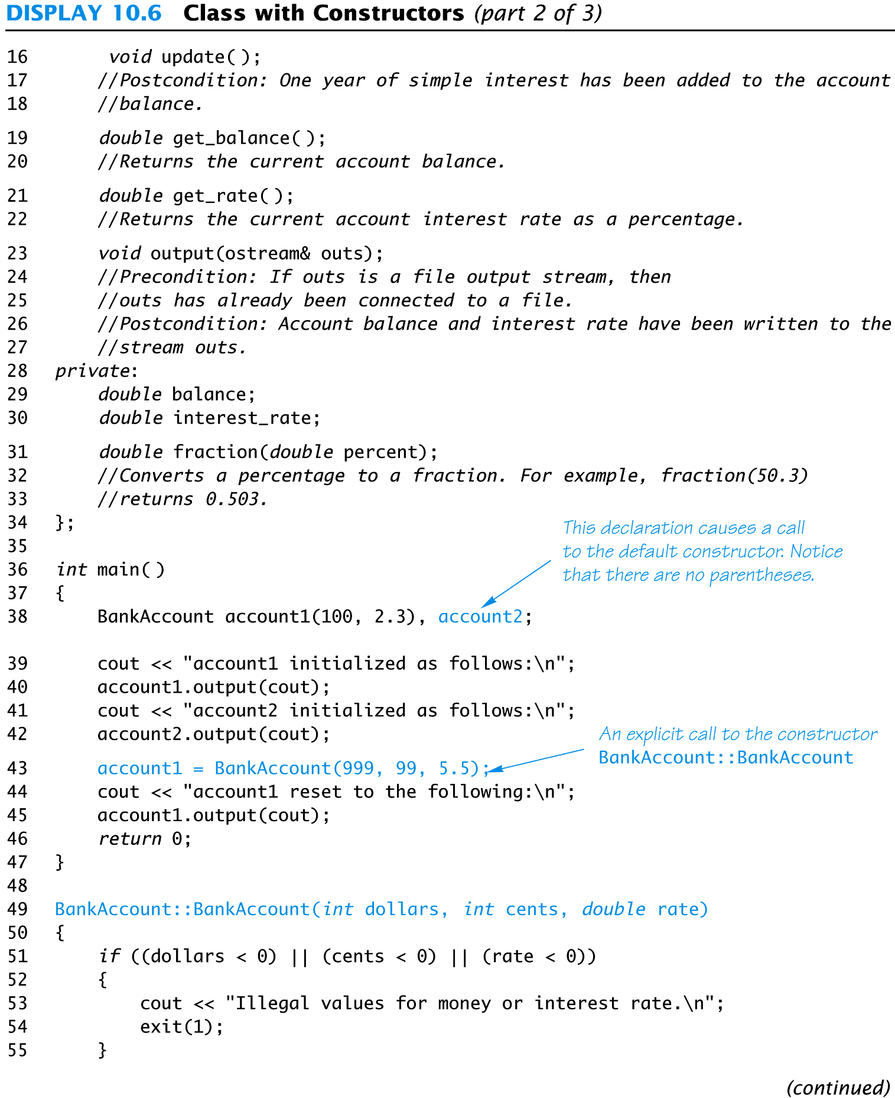
Display 10.6 (2/3)

Slide 68
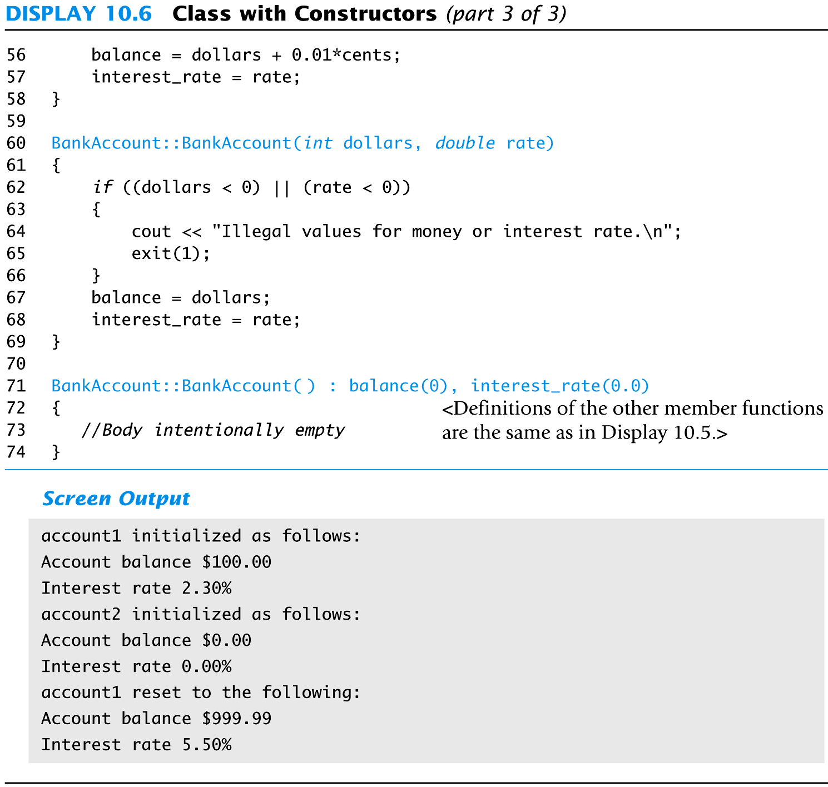
Display 10.6 (3/3)

Slide 69
Initialization Sections
An initialization section in a function definition provides an alternative way to initialize member variables
BankAccount::BankAccount( ): balance(0), interest_rate(0.0); { // No code needed in this example }
The values in parenthesis are the initial values for the member variables listed

Slide 70
Parameters and Initialization
Member functions with parameters can use initialization sections BankAccount::BankAccount(int dollars, int cents, double rate) : balance (dollars + 0.01 * cents), interest_rate(rate) { if (( dollars < 0) || (cents < 0) || (rate < 0)) { cout << “Illegal values for money or rate\n”; exit(1); } }
Notice that the parameters can be arguments in the initialization

Slide 71
Member Initializers
C++11 supports a feature called member initialization
Simply set member variables in the class
Ex: class Coordinate
{
private:
int x=1;
int y=2;
...
};
Creating a Coordinate object will initialize its x variable to 1 and y to 2 (assuming a constructor isn’t called that sets the values to something else)

Slide 72
Constructor Delegation
C++11 also supports constructor delegation. This lets you have a constructor invoke another constructor in the initialization section.
For example, make the default constructor call a second constructor that sets X to 99 and Y to 99:
Coordinate::Coordinate() : Coordinate(99,99)
{ }

Slide 73
Section 10.2 Conclusion
Can you
Describe the difference between a class and a structure?
Explain why member variables are usually private?
Describe the purpose of a constructor?
Use an initialization section in a function definition?

Slide 74
10.3
Abstract Data Types

Slide 75
Abstract Data Types
A data type consists of a collection of values together with a set of basic operations defined on the values
A data type is an Abstract Data Type (ADT) if programmers using the type do not have access to the details of how the values and operations are implemented

Slide 76
Classes To Produce ADTs
To define a class so it is an ADT
Separate the specification of how the type is used by a programmer from the details of how the type is implemented
Make all member variables private members
Basic operations a programmer needs should be public member functions
Fully specify how to use each public function
Helper functions should be private members

Slide 77
ADT Interface
The ADT interface tells how to use the ADT in a program
The interface consists of
The public member functions
The comments that explain how to use the functions
The interface should be all that is needed to know how to use the ADT in a program

Slide 78
ADT Implementation
The ADT implementation tells how the interface is realized in C++
The implementation consists of
The private members of the class
The definitions of public and private member functions
The implementation is needed to run a program
The implementation is not needed to write the main part of a program or any non-member functions

Slide 79
ADT Benefits
Changing an ADT implementation does require changing a program that uses the ADT
ADT’s make it easier to divide work among different programmers
One or more can write the ADT
One or more can write code that uses the ADT
Writing and using ADTs breaks the larger programming task into smaller tasks

Slide 80
Program Example The BankAccount ADT
In this version of the BankAccount ADT
Data is stored as three member variables
The dollars part of the account balance
The cents part of the account balance
The interest rate
This version stores the interest rate as a fraction
The public portion of the class definition remains unchanged from the version of Display 10.6

Slide 81
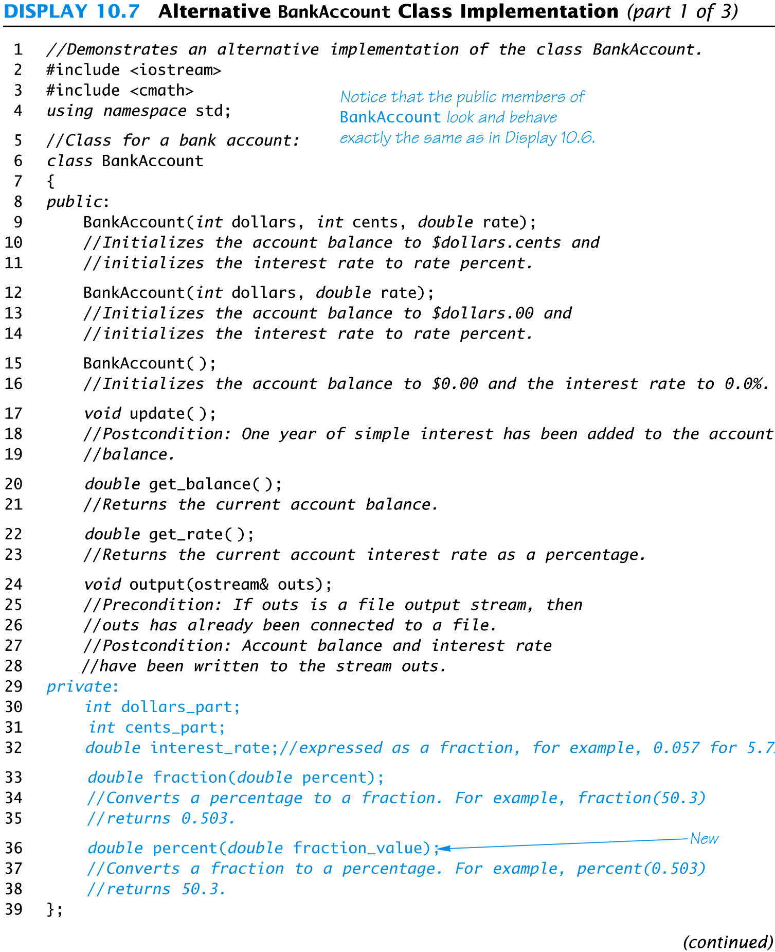
Display 10.7 (1/3)

Slide 82
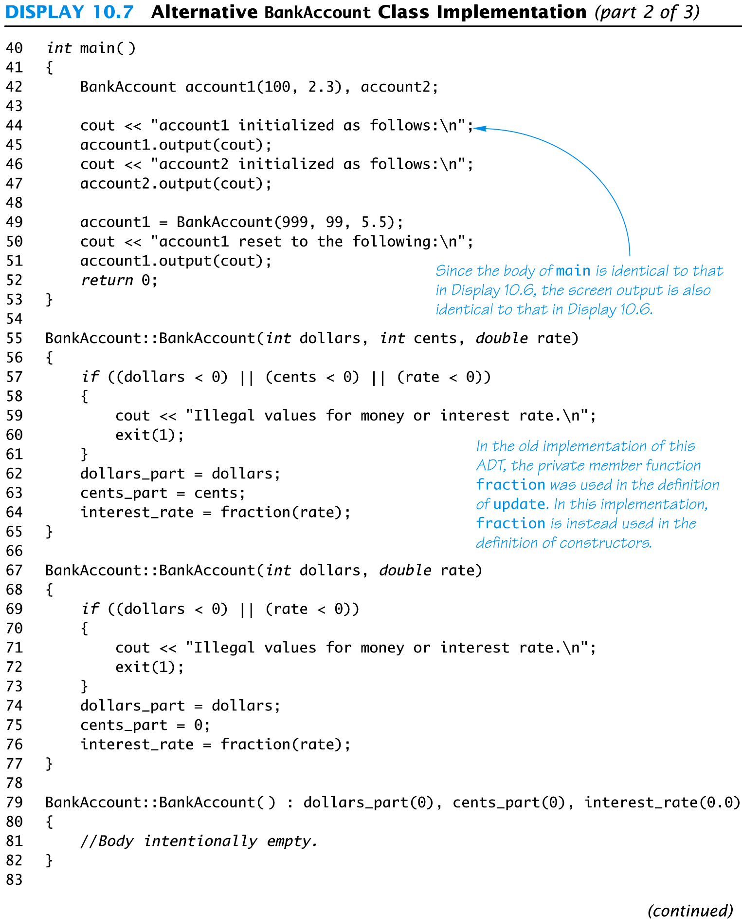
Display 10.7 (2/3)

Slide 83
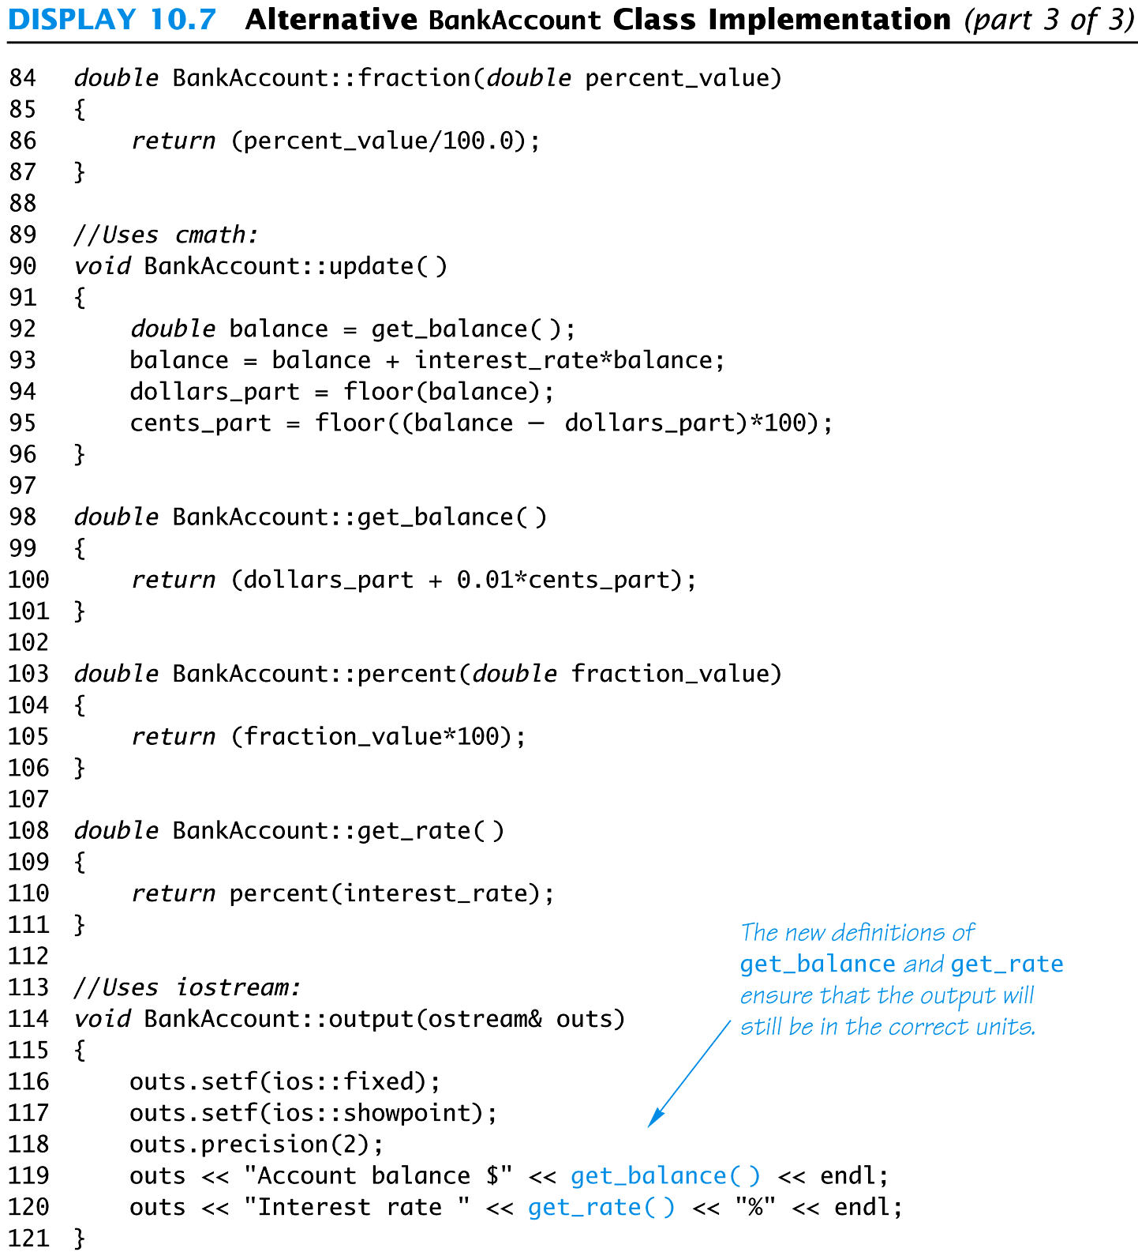
Display 10.7 (3/3)

Slide 84
Interface Preservation
To preserve the interface of an ADT so that programs using it do not need to be changed
Public member declarations cannot be changed
Public member definitions can be changed
Private member functions can be added, deleted, or changed

Slide 85
Information Hiding
Information hiding was refered to earlier as writing functions so they can be used like black boxes
ADT’s implement information hiding because
The interface is all that is needed to use the ADT
Implementation details of the ADT are not needed to know how to use the ADT
Implementation details of the data values are not needed to know how to use the ADT

Slide 86
Section 10.3 Conclusion
Can you
Describe an ADT?
Describe how to implement an ADT in C++?
Define the interface of an ADT?
Define the implementation of an ADT?

Slide 87
10.4
Introduction to Inheritance

Slide 88
Inheritance
Inheritance refers to derived classes
Derived classes are obtained from another class by adding features
A derived class inherits the member functions and variables from its parent class without having to re-write them
Example
In Chapter 6 we saw that the class of input-file streams is derived from the class of all input streams by adding member functions such as open and close
cin belongs to the class of all input streams, but not the class of input-file streams

Slide 89
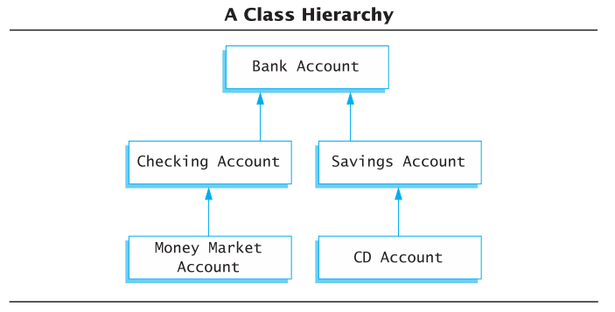
Inheritance Example
Natural hierarchy of bank accounts
Most general: A Bank Account stores a balance
A Checking Account “IS A” Bank Account that allows customers to write checks
A Savings Account “IS A” Bank Account without checks but higher interest
Accounts are more specific as we go down the hierarchy
Each box can be a class

Slide 90
Inheritance Relationships
The more specific class is a derived or child class
The more general class is the base, super, or parent class
If class B is derived from class A
Class B is a derived class of class A
Class B is a child of class A
Class A is the parent of class B
Class B inherits the member functions and variables of class A

Slide 91
Defining Derived Classes
Give the class name as normal, but add a colon and then the name of the base class
Objects of type SavingsAccount can access member functions defined in SavingsAccount or BankAccount
class SavingsAccount : public BankAccount
{
…
}

Slide 92
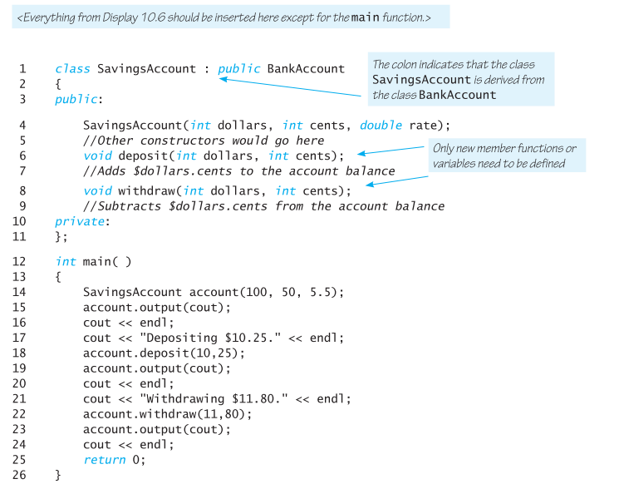
Display 10.9 (1/3)

Slide 93
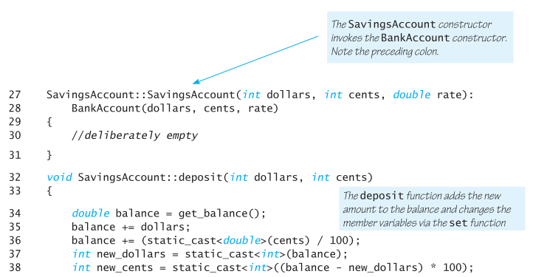
Display 10.9 (2/3)

Slide 94
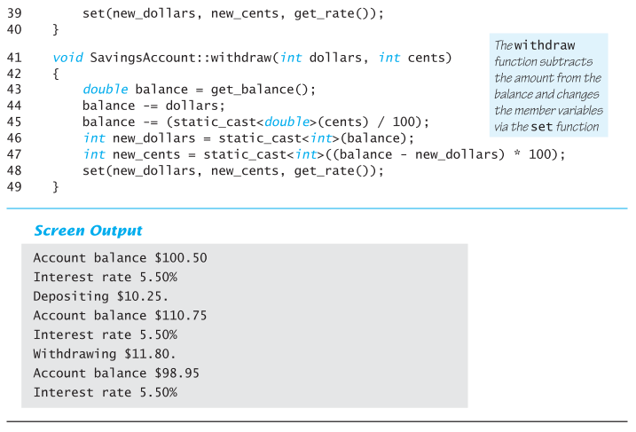
Display 10.9 (3/3)

Slide 95
Section 10.4 Conclusion
Can you
Define object?
Define class?
Describe the relationship between parent and child classes?
Describe the benefit of inheritance?

Slide 96
Chapter 10 -- End

Slide 97
Display 10.8

